Slide 1
Harry Potter Fan Fiction
Preliminary Results

Slide 2
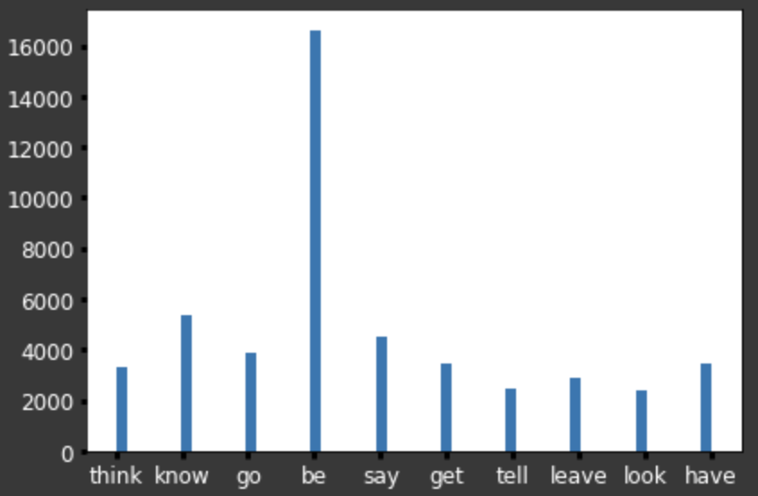
Most Common Words

Slide 3
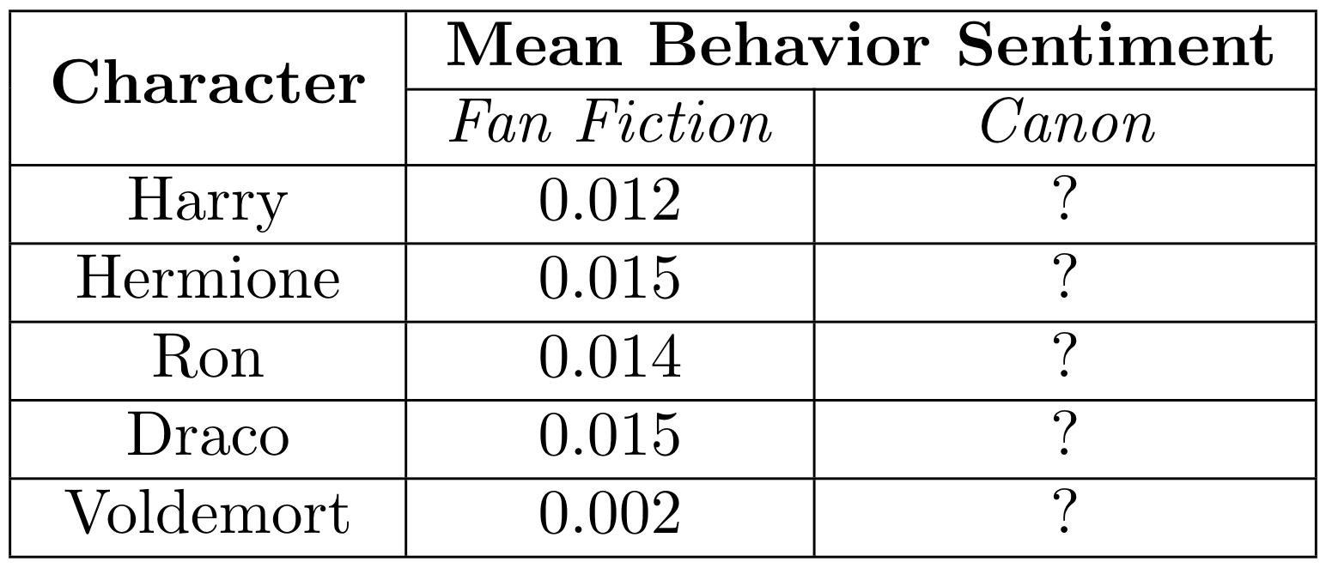
Sentiment Analysis

Slide 4
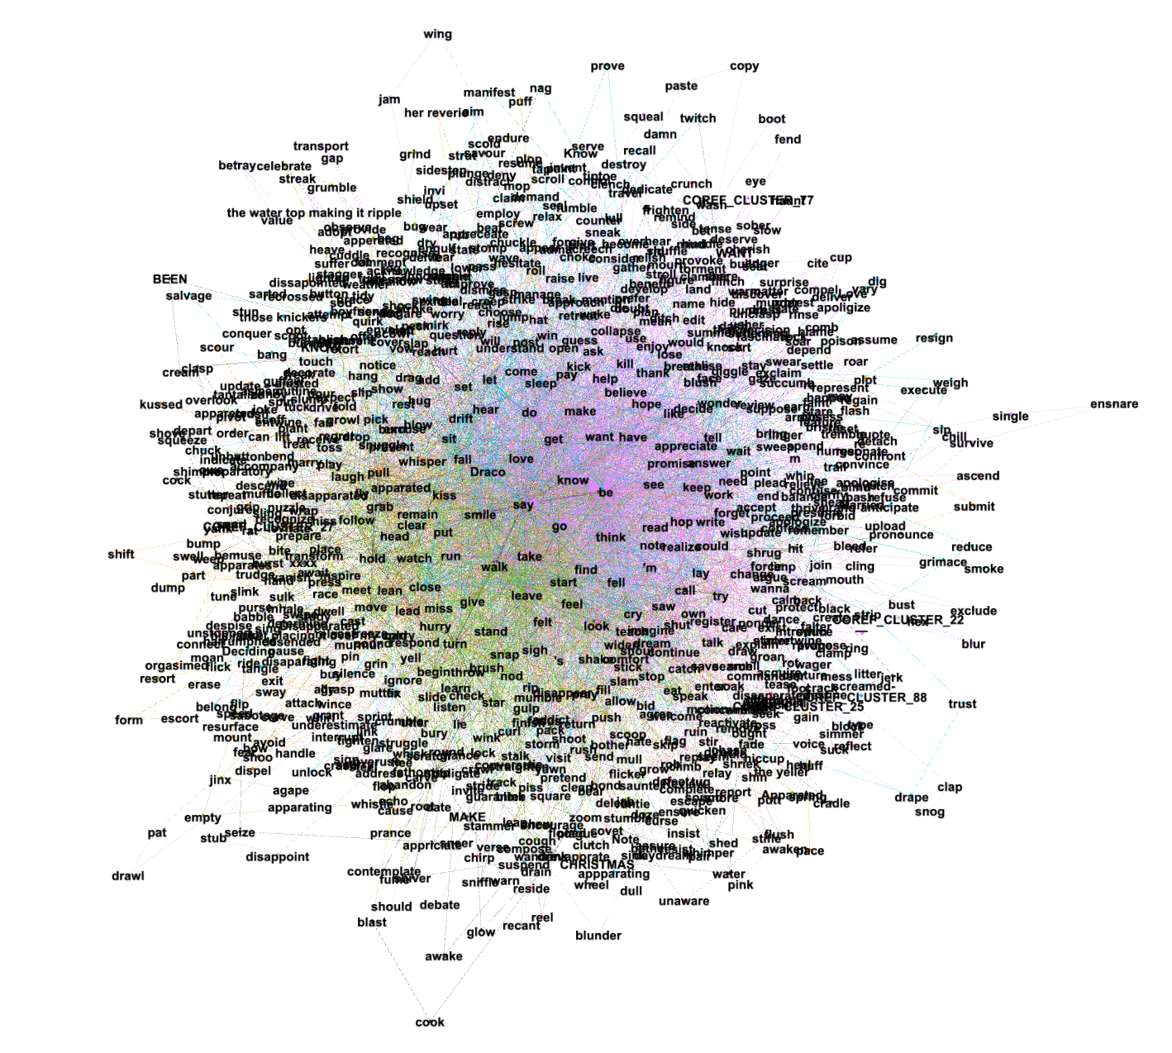
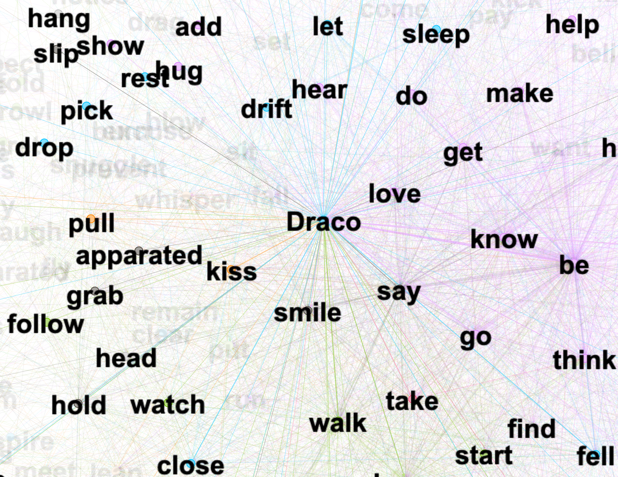
Draco’s Verb Net

Slide 5
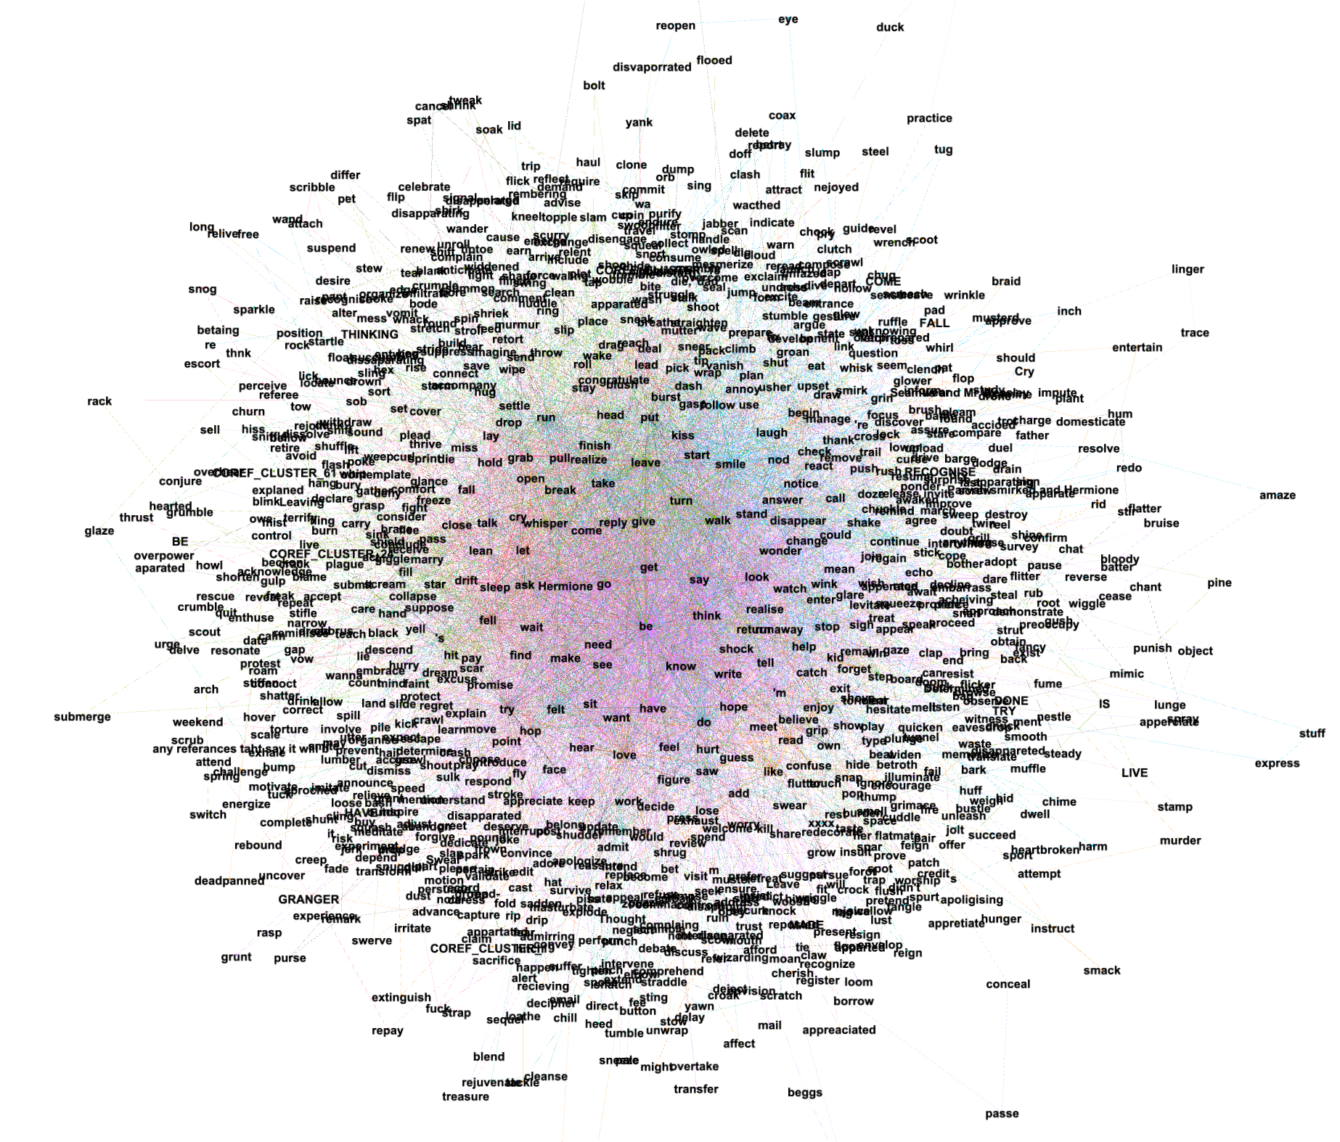
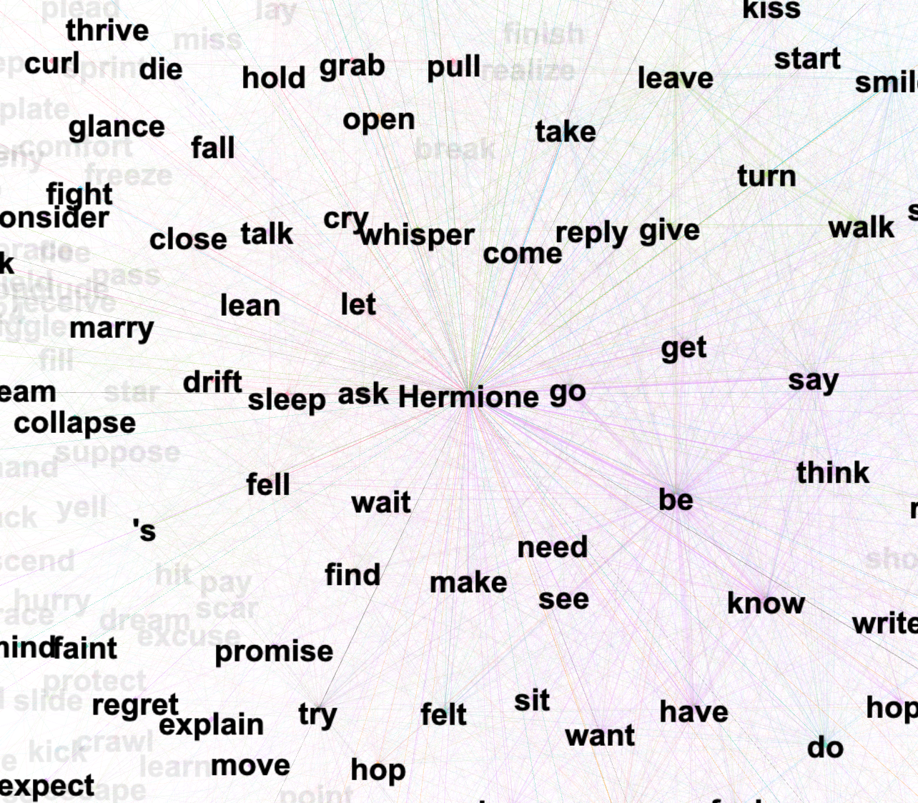
Hermione’s Verb Net

